Slide 1
CDR Presentation
Emergency Response Mapping Sphere
Team ERMS
Brandon Le, Kiet Nguyen, Hai Yen Nguyen, Antony Quach, Josh Wu

Slide 2
Problem Statement
Emergency response operations require rapid, accurate situational awareness in hazardous environments.
First responders routinely enter dangerous, unfamiliar environments with limited visibility.
This increases the risk of injury, delayed rescue, and poor tactical decisions.
Existing technologies, such as drones, body-worn cameras, and robots often provide incomplete or unreliable information.
Current technologies do not sufficiently reduce operational risk due to impracticality to deploy in confined or chaotic events.
Notes:
First responders routinely enter dangerous and unfamiliar environments with limited situational awareness, increasing the likelihood of injury, delayed rescue, and poor tactical decision-making.
Existing technologies, such as drones, body-worn cameras, and robots are often not good enough for current situations, and do not significantly reduce risks for first responders.

Slide 3
Requirements
Performance
The ball should take no longer than 30 seconds from capturing the first image to displaying a 3D model of the environment.
The ball should achieve at least 5 fps streaming at 720p resolution.
Functionality
The cameras and raspberry pi should all fit inside the ball and remain functional while the ball is rolling.
The ball should be able to identify which camera is facing downwards.
The ball should require minimal setup for operators, not exceeding 20 seconds to prepare to throw the ball.
Energy
The ball should reduce power consumption by cutting the downward facing camera when not needed.
Environmental
The ball should not exceed 7 inches in diameter for portability.
Notes:
First responders routinely enter dangerous and unfamiliar environments with limited situational awareness, increasing the likelihood of injury, delayed rescue, and poor tactical decision-making.
Existing technologies, such as drones, body-worn cameras, and robots are often not good enough for current situations, and do not significantly reduce risks for first responders.

Slide 4
Requirements
Economic
The prototyping cost of the ball should not exceed $250
Legal
The system shall use a commercial Wi-Fi module with documented FCC compliance.
Safety
The ball enclosure shall be constructed from a material with a documented flame resistance rating to protect internal electronics from ignition
Maintainability
The ball shall allow access to internal electronics using standard tools without damaging the enclosure
Usability
The system shall provide a user interface that can be operated without requiring programming knowledge.
Reliability
The ball should be able to withstand a 2-meter drop with no damage to the external structure or internal electronics.
Notes:
First responders routinely enter dangerous and unfamiliar environments with limited situational awareness, increasing the likelihood of injury, delayed rescue, and poor tactical decision-making.
Existing technologies, such as drones, body-worn cameras, and robots are often not good enough for current situations, and do not significantly reduce risks for first responders.

Slide 5
Testable specification for requirements
Requirement Type | Requirement | Verification Method | Pass Criteria
Performance | 3D Model generated ≤ 30s | Timestamp logging | ≤ 30 seconds
Performance | Stream ≥ 5 fps at 720p resolution | Measure frame rate over 60-second streaming sessions using software like OpenCV | Average ≥ 5 fps sustained
Functionality | Components fit & remain functional while in motion | Physical assembly check and rolling tests. | All components fit and all cameras operational during rolling test
Functionality | Detect orientation and downward-facing camera | Orientation test (6 positions) and compare sensor output to ground truth | ≤ 95% of trials correct
Functionality | System setup for throwing ball should take ≤ 20s | Time operator from power-on to throw-ready | ≤ 25s on average

Slide 6
Testable specification for requirements
Requirement Type | Requirement | Verification Method | Pass Criteria
Energy | Reduce power by disabling downward camera | Measure current draw with and without IMU and camera disabling | ≥ 15% reduction
Environmental | Ball diameter ≤ 7 inches for portability | Measure final assembled ball diameter | ≥ 7 inches
Economic | Prototyping cost < $250 | Inspection of Bill of Materials | Total cost is less than $250
Legal | Use FCC compliant Wi-Fi modules | Inspection of module documentation | Datasheet shows FCC compliance

Slide 7
Testable specification for requirements
Requirement Type | Requirement | Verification Method | Pass Criteria
Safety | Shell should be made of fire resistant material | Inspection of material datasheet | Datasheet shows material withstands heat up to 100 C
Maintainability | Internal electronics accessible by standard tools | Disassemble and reassemble using standard screwdrivers | Test is performed with no structural damage
Usability | GUI is usable without requiring coding | User test demonstration | A user with no programming background completes defined tasks successfully
Reliability | Survive 2m drop without damage | Drop test from 2 meters (3 trials) onto concrete | No structural damage, system still functional

Slide 8
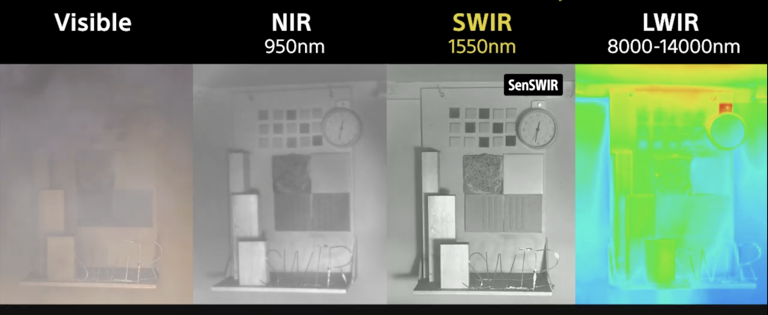
Design Alternatives
Raspberry Pi
Pi 5: 4 GB RAM processes better but significantly higher power consumption. Requires a larger battery and increasing cost of battery too high for our budget
Pi 4 (Selected): Sufficient processing capability while maintaining lower power consumption and cost
Camera Modules
Standard Camera Module 3: Narrow field of view requires more cameras
Wide Camera Module 3: Has 120° angle of view, but lacks IR capability
Module 3 Wide NoIR Camera (Selected): IR-sensitive with 120°, enabling 3D reconstruction in smoke-filled environments.
Gyroscope
Gyro 5 Click: High sensitivity but more expensive and complex to integrate
Adafruit ISM330DHCX (Selected): accelerometer and gyroscope, easy integration
Battery
High-capacity battery: Longer runtime but heavier and larger
Moderate-capacity battery (Selected): Balanced runtime,
weight, and space for the ball

Slide 9
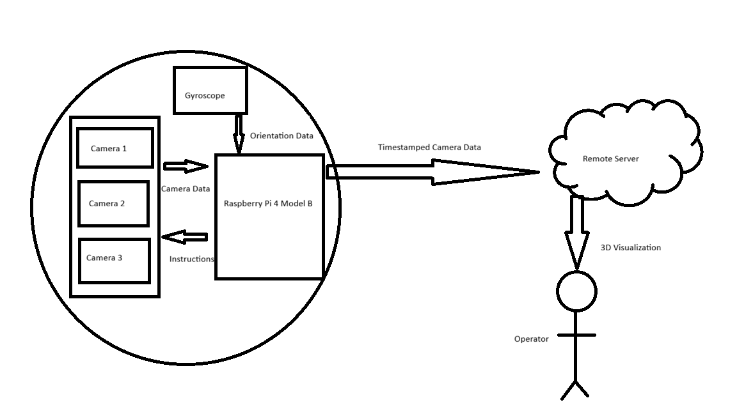
System-Level functional Description
A throwable ball containing cameras and electronics that can be tossed into an environment
Once deployed, the ball captures wide-angle photos from each camera and transmits them to remote server via TAMU IoT
Once received by server, it synchronizes the data and performs 3D reconstruction via 3D Gaussian Splatting
Resulting 3D model sent to connected device for operator to inspect
Monitoring Unit

Slide 10
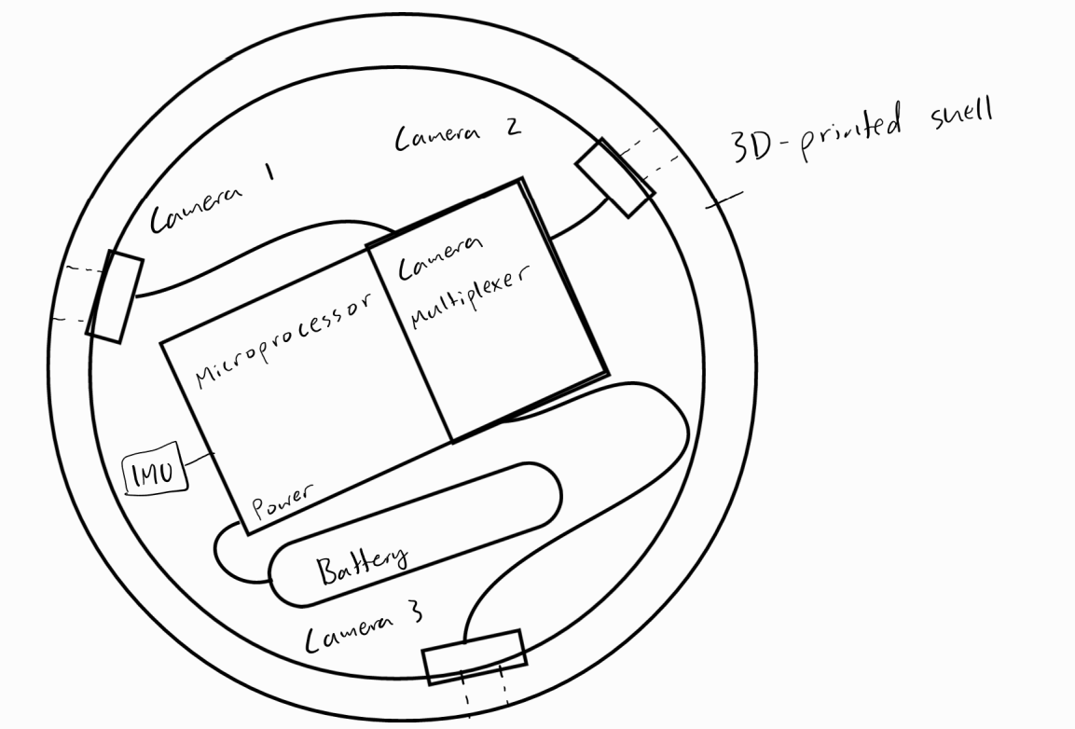
Hardware Design: Throwable Ball
Physical Shell: 3D-printed/CAD Design
(ABS filament for temperature resistance)
Components:
Raspberry Pi 4B microprocessor
Camera multiplexer
3 Camera modules
Portable USB battery bank
IMU Sensor (For camera-cut alg)
Overview
Cameras connected to Pi via Multiplexer
IMU Sensor connected to Pi
All components powered by a portable battery bank through the Pi
Cameras and Pi are mounted by screws
Battery→Pi (Initializing power source)
Raspberry Pi→Camera Multiplexer→Cameras

Slide 11
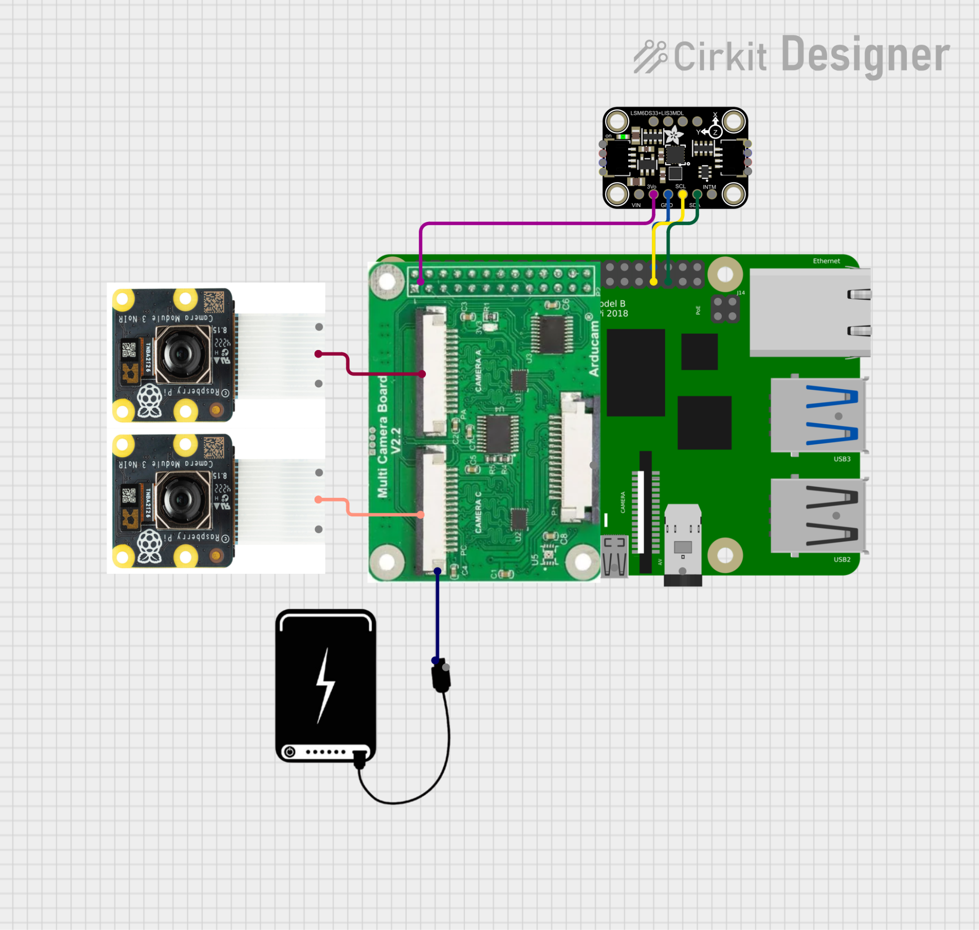
Hardware Design: Interfaces
Camera Multiplexer
Hardware Attached on Top (HAT) board that sits on top of Pi GPIO pins 1-26 using stacking header, Pi camera port via FPC ribbon
3 Cameras (one not pictured)
Connect to one multiplexer input port using FPC ribbon
Battery
Connects to Pi power port using USB-C
Gyroscope (IMU)
Connect to Pi GPIO pins: 3v3 via stacking header to pin 1, GND via pin 30, and use “bit-banging” to repurpose pins 29 and 31 to SDA, SCL

Slide 12
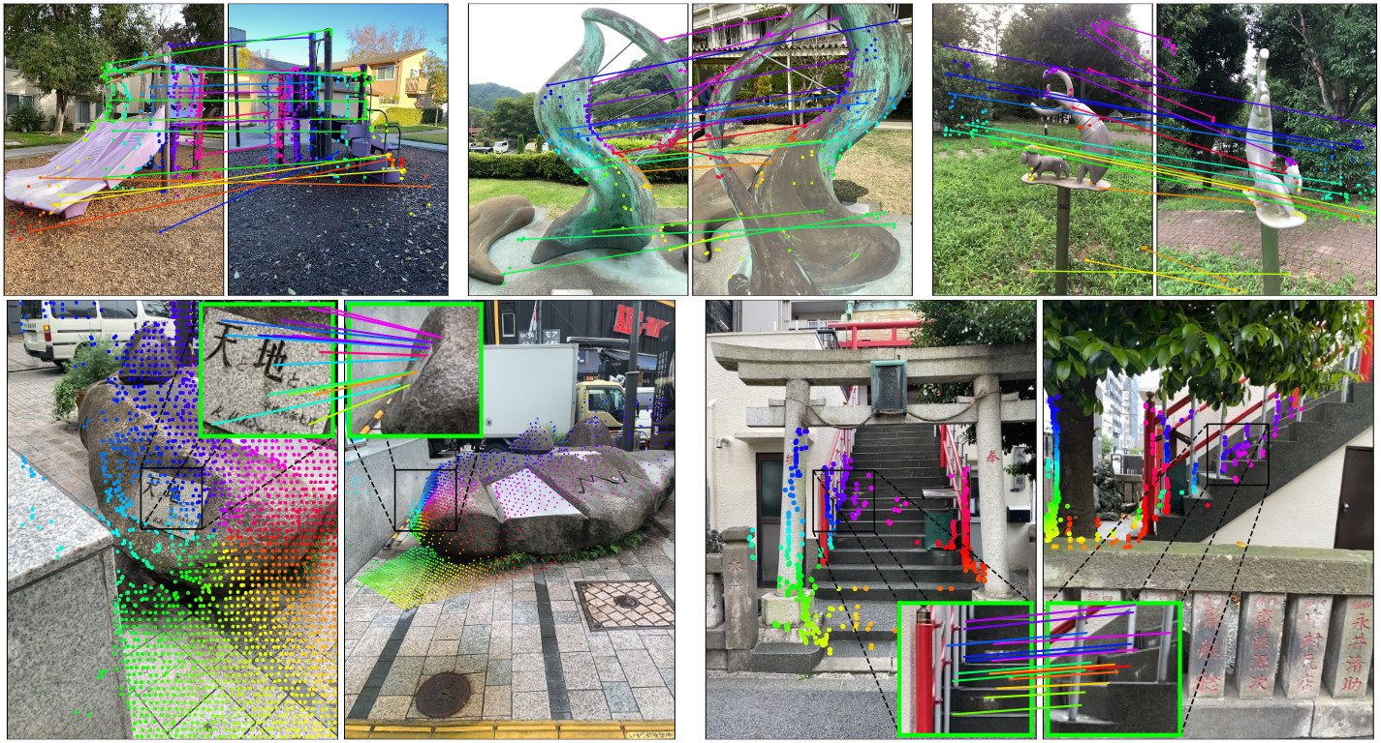
Software Design: Server Connection
Network Architecture
Tailscale VPN Mesh Networking
Secure encrypted tunnel between ball and server
Works across different physical Wi-Fi networks
Data Transmission
From Ball to Server
Synchronized camera frames (JPEG compressed)
IMU orientation data
Timestamps for frame alignment
HTTP Post via FastAPI endpoint
From Server to Operator
WebRTC streaming of rendered 3D model
Real-time visualization updates
Server process image
Ball
Remote Operator navigates 3D scene

Slide 13
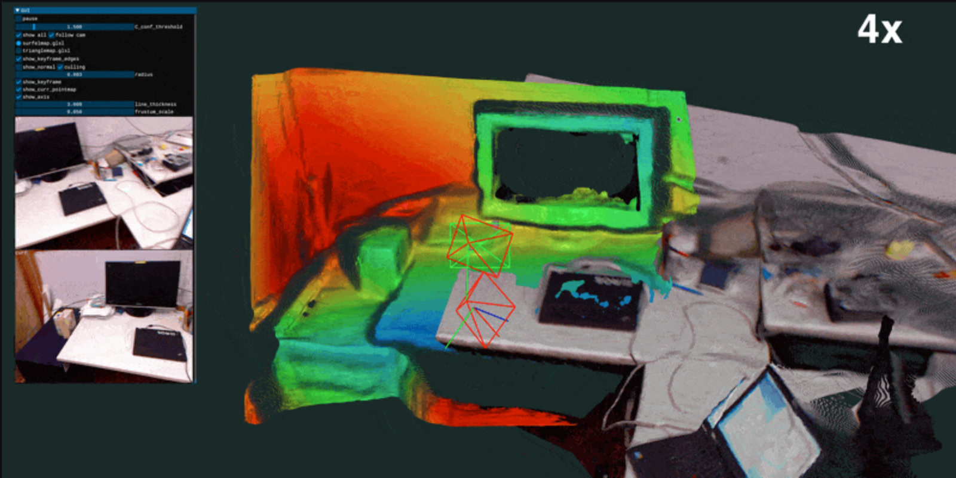
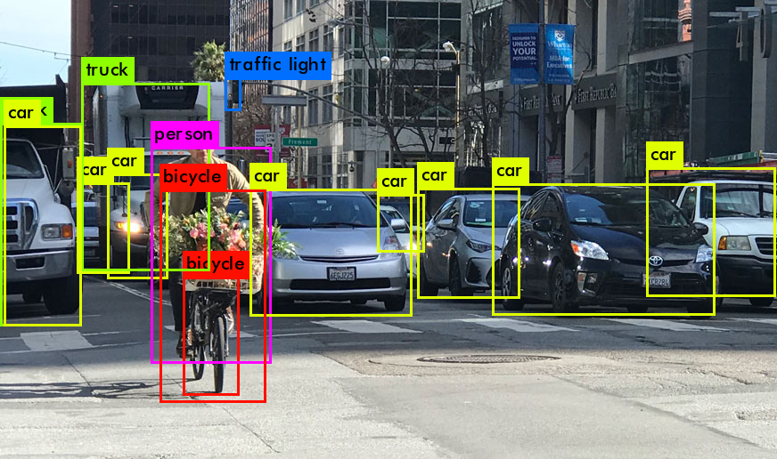
Software Design: SLAM + 3D-Mapping
Step 1: SLAM (Simultaneous Localization and Mapping)
Estimates camera position and orientation for each frame
Uses IMU data to improve pose estimation accuracy
Tracks ball’s trajectory through the environment
Step 2: 3D Gaussian Splatting
Reconstructs environment
Refines geometry based on SLAM-estimated camera poses
Generates photorealistic 3D scene
Step 3: Object Detection & Threat Identification
YOLO (You Only Look Once) based method
Flags moving objects
Server
Ball
Render image

Slide 14
Software Design: Camera Multiplexing
For most orientations, one camera will be pointing downwards, rendering it ineffective. We can disable the downward camera
Requires two components:
A gyroscope to determine orientation
A camera adapter to multiplex multiple cameras to one board
Reduces power consumption, wear on cameras, and points of failure

Slide 15
Software Design: Server
Ideal specs:
Pricing/hr: <$2
GPU name: RTX 3090
VRAM: 16-32 GB
memory bandwidth: 936 GB/s
CPU spec: AMD 7900X (12 core, 24 thread, equivalent ~24 vCPUs)
Proximity: located in central US
Storage: 100 GB
Fallback:
Due to low availability among cloud providers, we plan to use a GPU laptop.

Slide 16
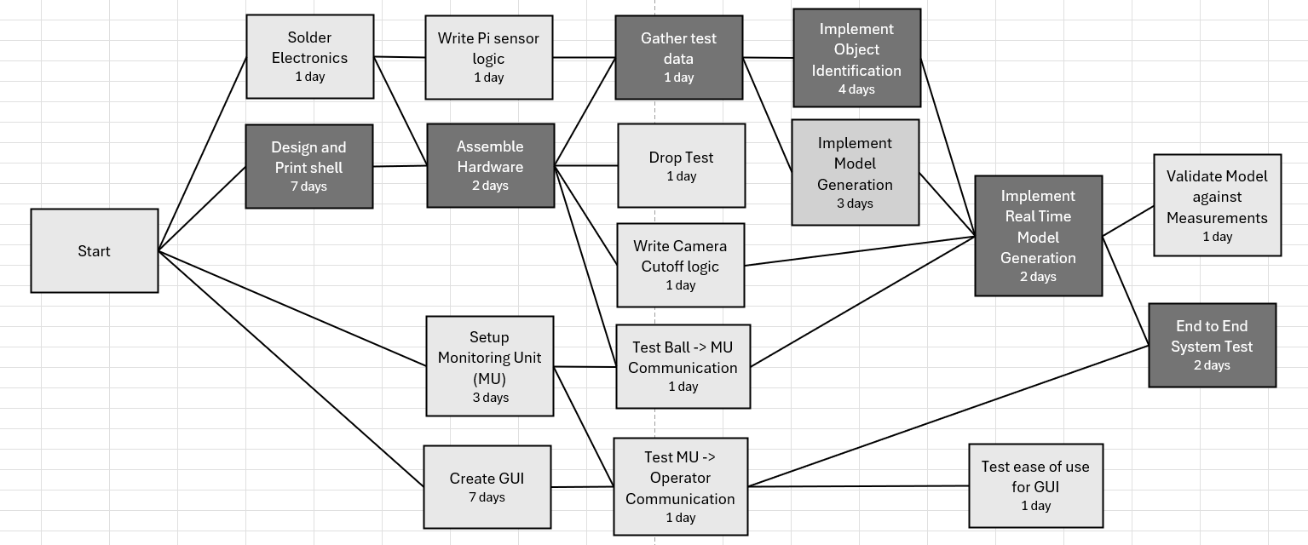
Timeline and Project Planning
Critical Path - 18 days

Slide 17
Validation/Test Plan
Camera Capture & Identification
Verify image accuracy by comparing console output to actual room layouts
User Interface & Display
Evaluate responsiveness and ease of use through operator trials and feedback
Durability & Impact Resistance
Perform repeated 2m drop tests; system must remain fully functional
Mapping & Decision Algorithms
Validate 3D model accuracy by benchmarking against real room measurements

Slide 18
Vision for Demonstration
System: Demonstrate as would be used by an operator - roll ball across floor of room, show the resulting model
Fire application: trap smoke from varying amounts of incense in container

Slide 19
Effective Teaming
We split the tasks over spring break as follows:
Multiplexer test: Antony
Smoke test: Hai Yen
Cloud setup: Brandon and Josh
CAD: Kiet
We plan to continue using meetings as discussion and task assignment time while doing research and development independently

Slide 20
Preliminary Results
Successfully set up Camera multiplexer with 2 cameras
NoIR camera (camera 1)
Regular camera (camera 0)
Conducted camera vision comparison in a smoke environment via incense candles in a clear container
Results:
NoIR camera displayed the active burning sites on the candle as bright blue
NoIR camera images were generally more bright and clear
However, the live feeds were somewhat similar

Slide 21
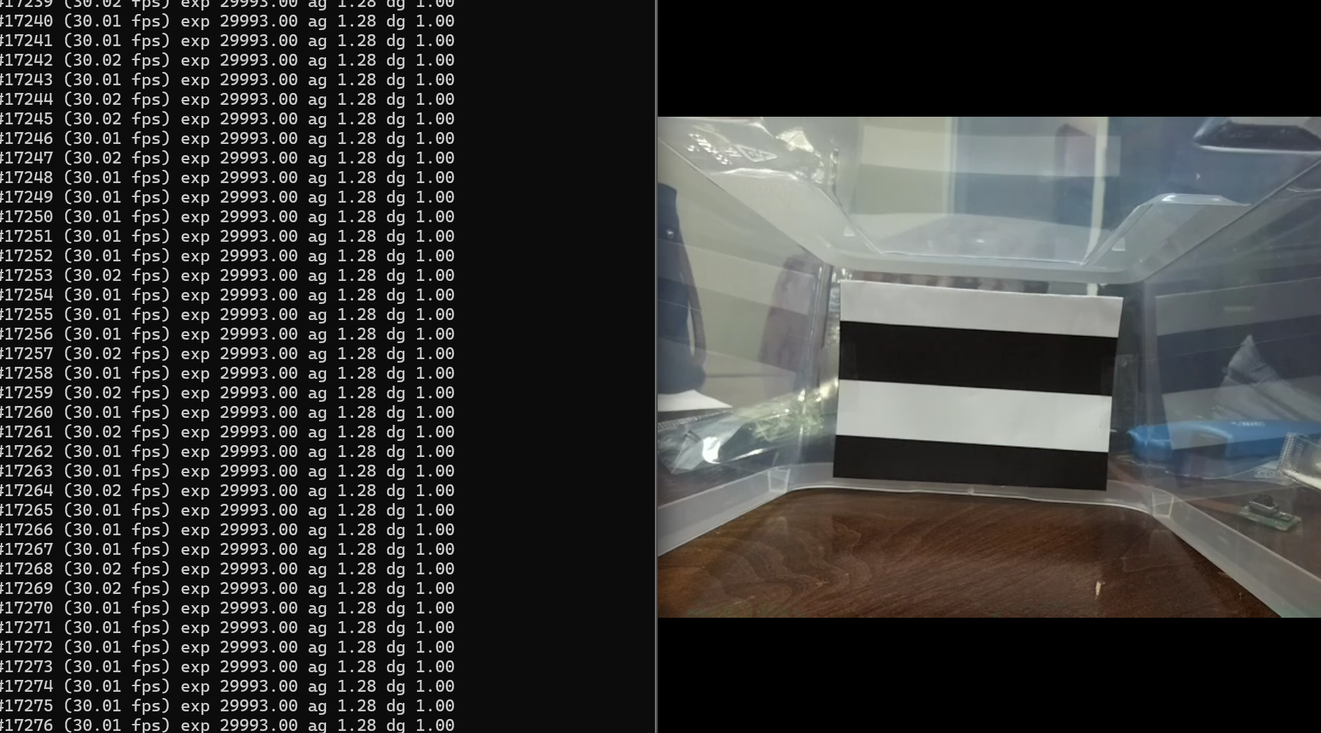
Smoke Test
Procedure per smoke level:
1. Set the smoke level using incense sticks
2. Wait 60 seconds for smoke to stabilize
3. Capture images with first Camera (Regular)
4. Switch cameras with multiplexer
5. Wait ~5 sec for camera to stabilize
6. Capture images with second camera (NoIR)
Contrast CDI measures how well the camera can distinguish between the bright white stripes and dark black stripes on the target pattern, so the higher the number, the better.
It ranges from 0 to 1:
1.0 = perfect: the camera sees pure white and pure black, no smoke interference
0.0 = completely degraded: everything looks the same gray, the stripes are invisible

Slide 22
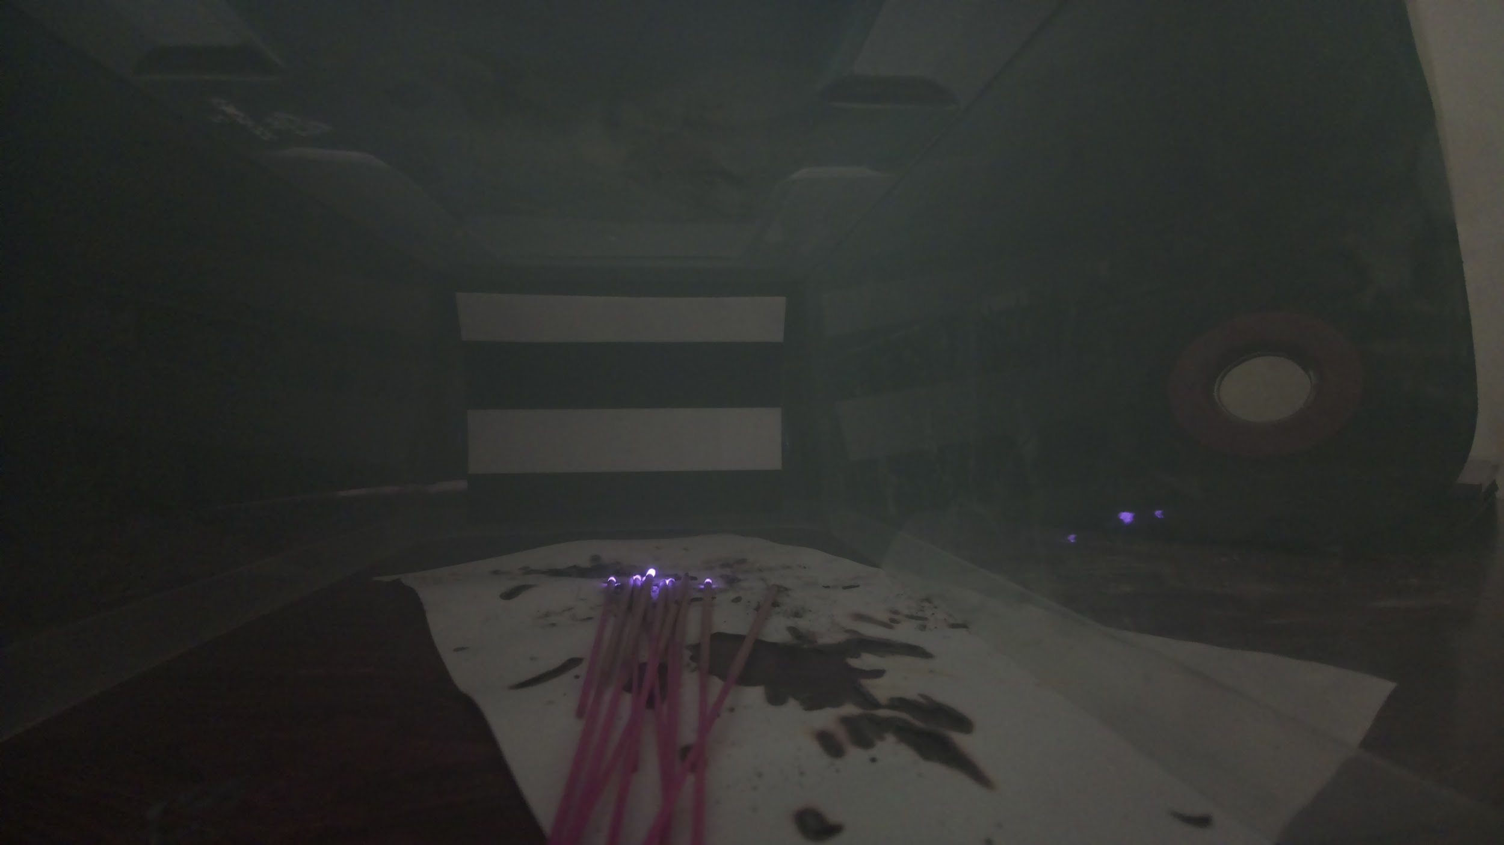
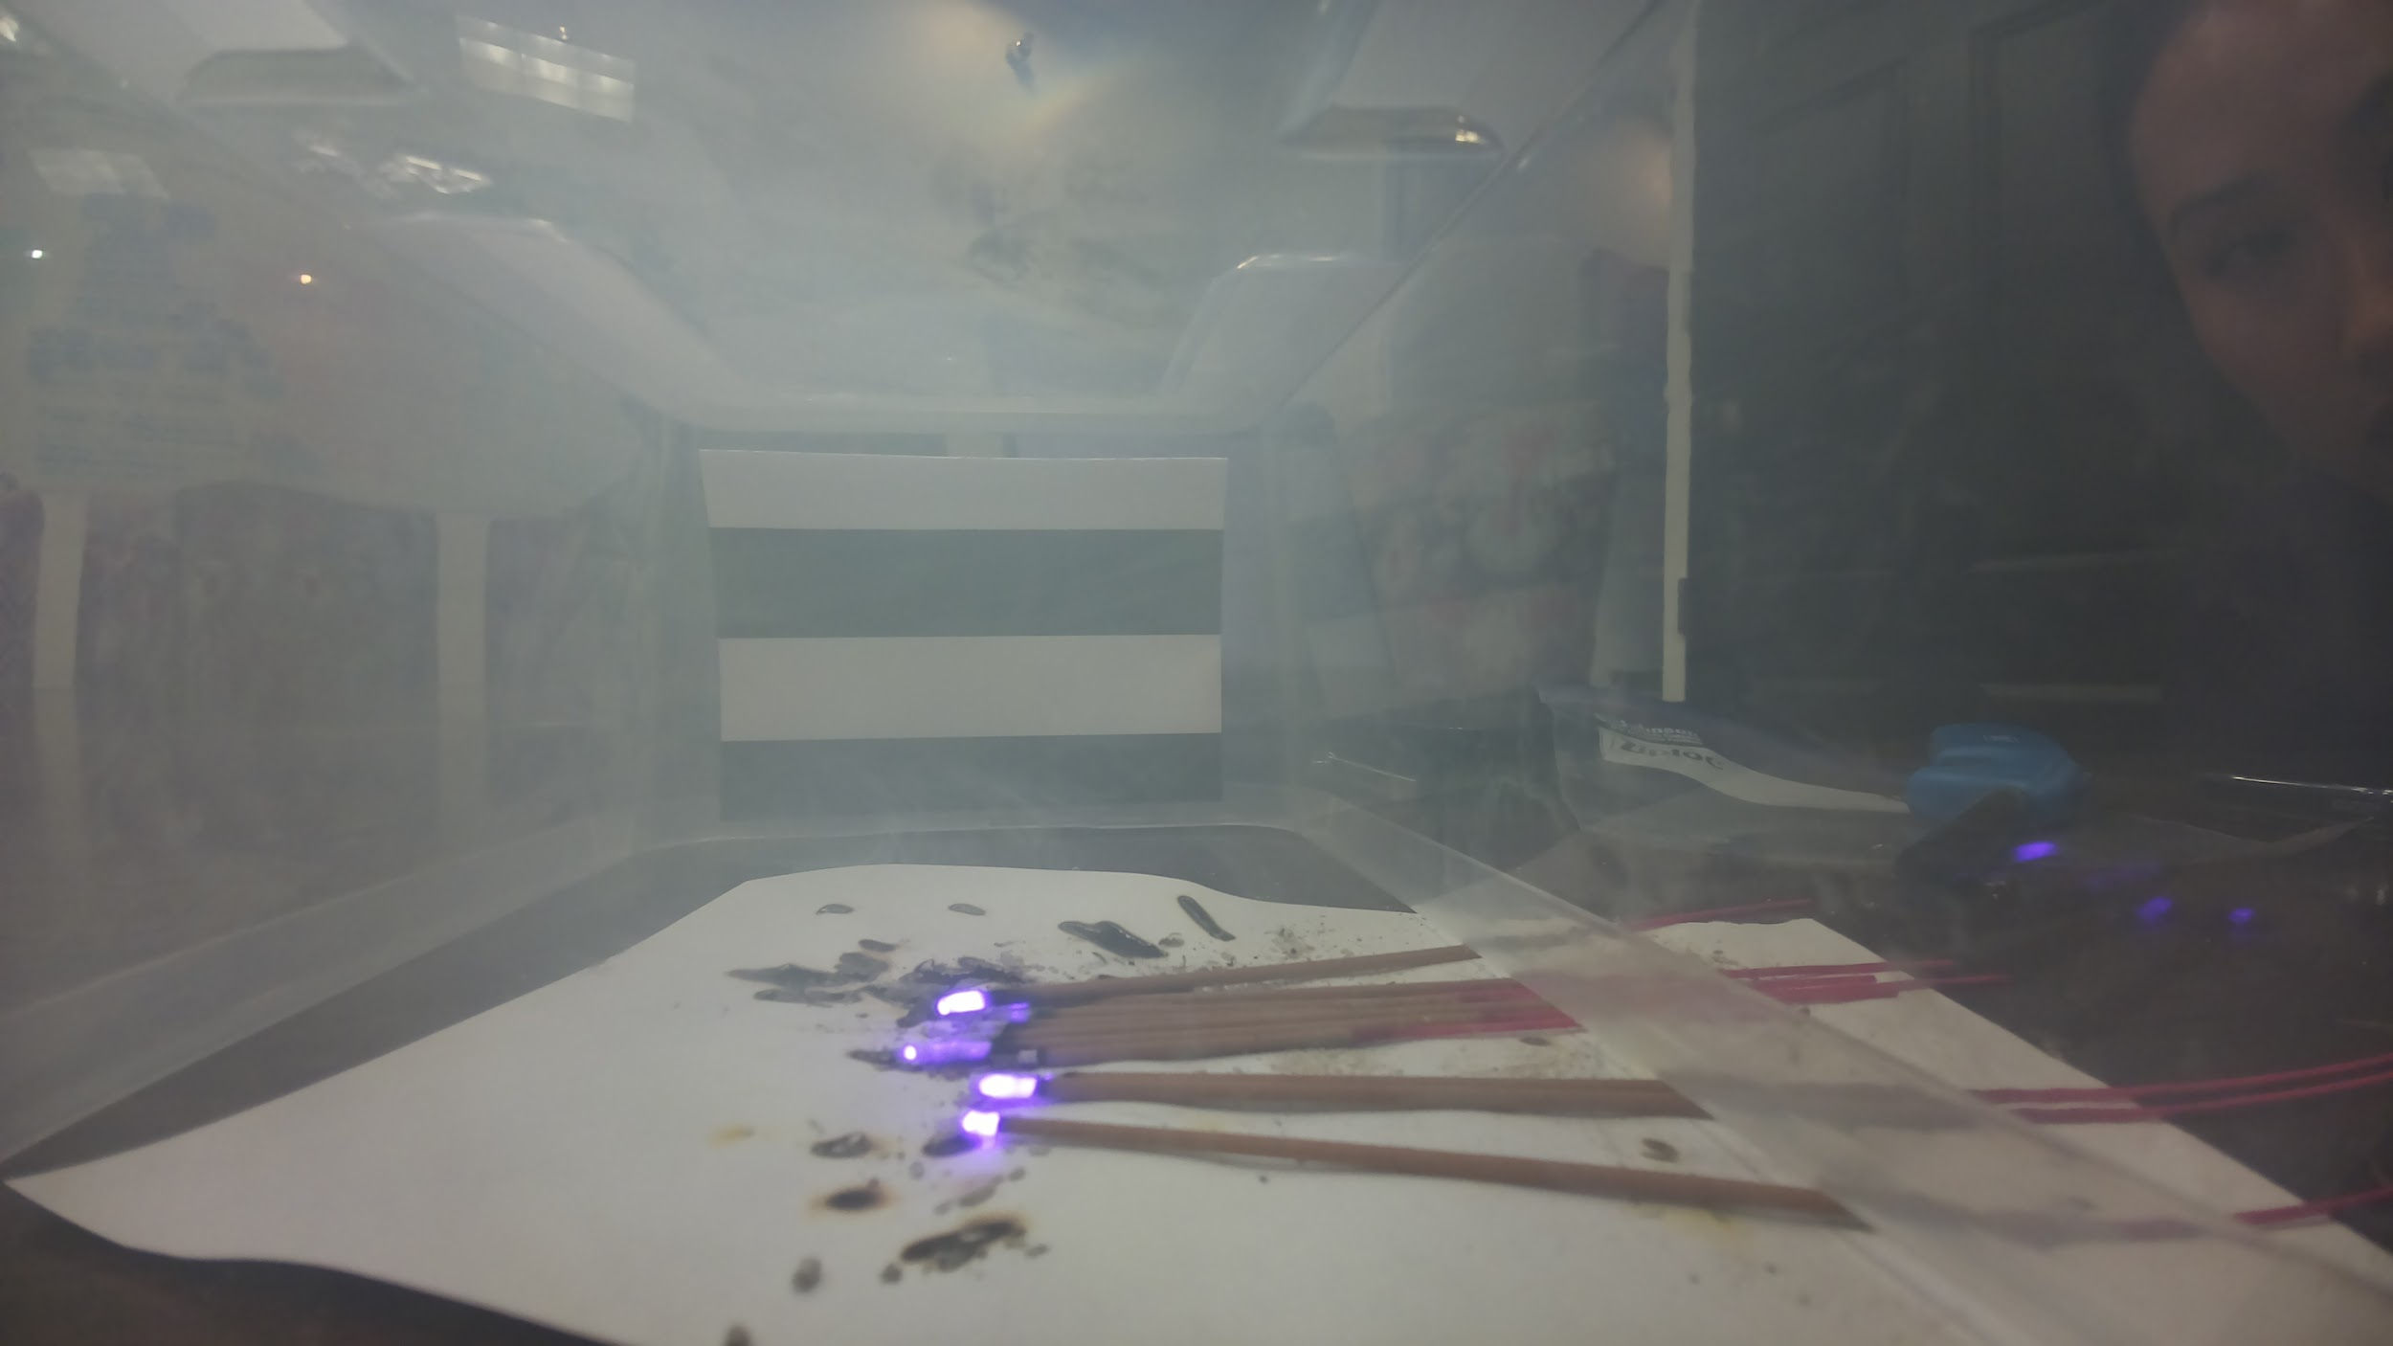
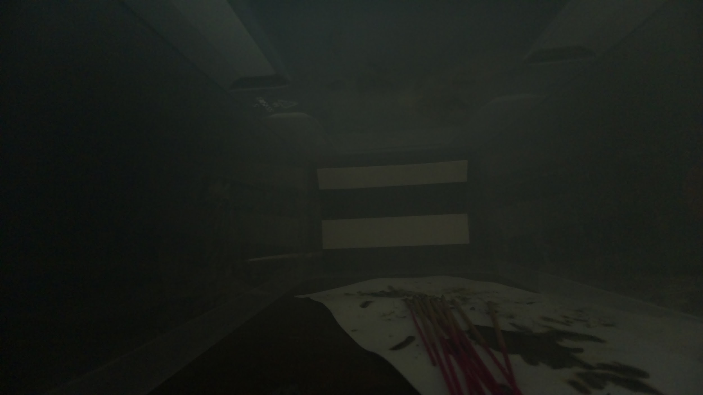
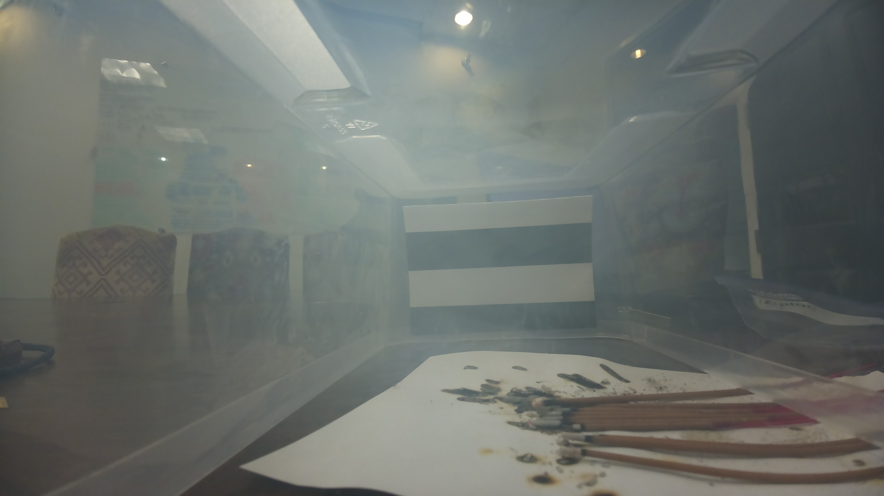
Smoke Test - 11 Sticks
dark
light
NoIR
(IR + RGB camera)
Regular

Slide 23
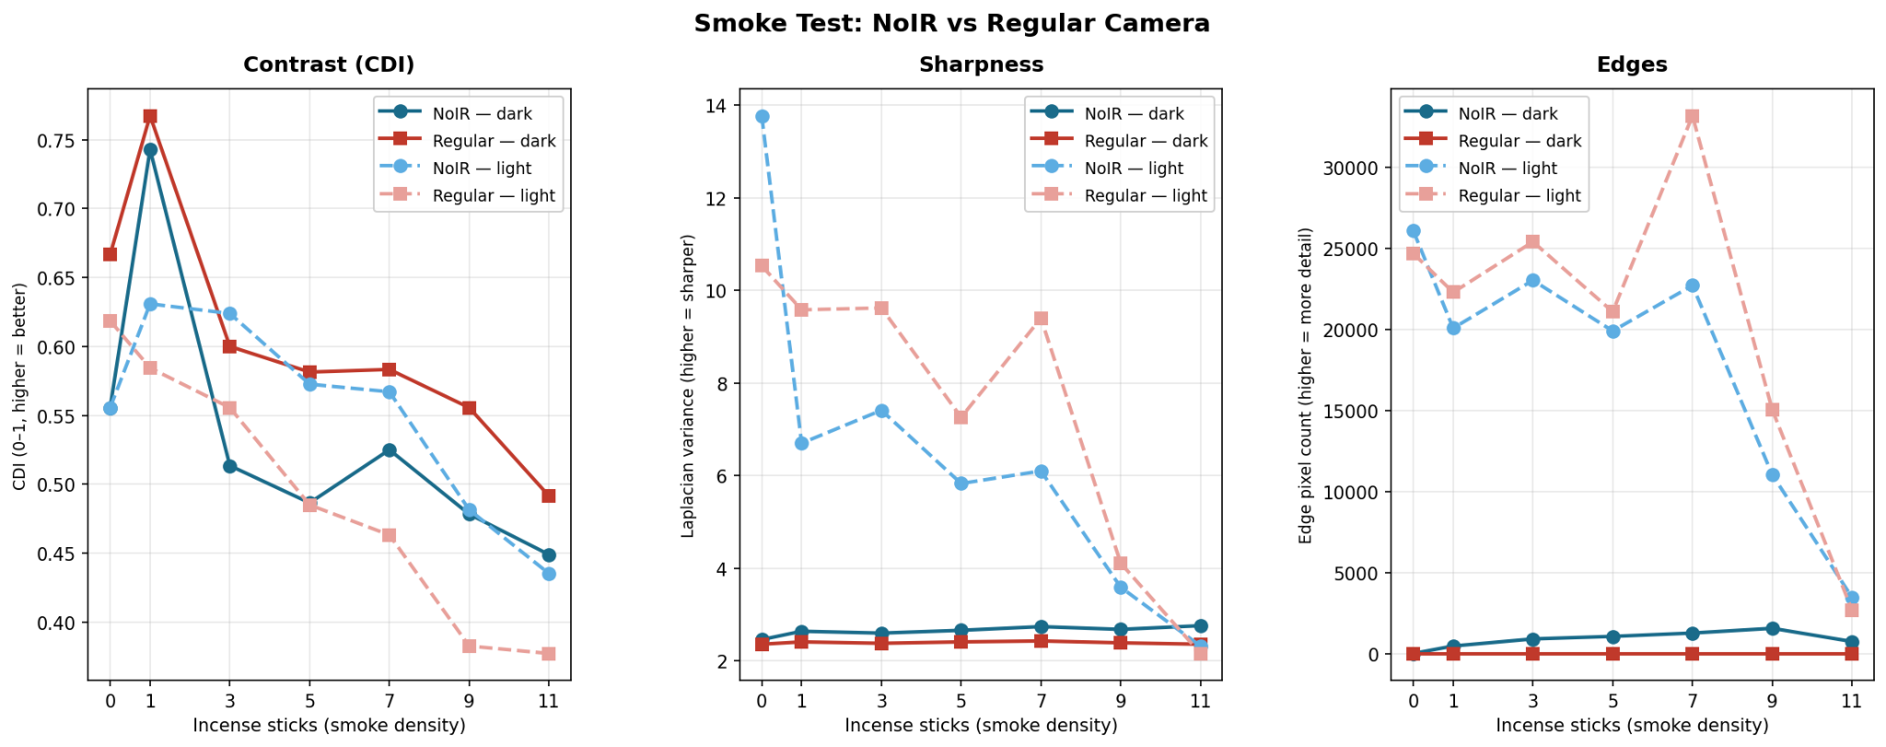
Smoke Test Results
Smoke consistently degrades image quality across all three metrics
In darkness, the NoIR camera significantly outperforms the regular camera (the regular camera detects almost no edges at any smoke level while the NoIR continues to detect edges throughout)
In normal lighting, both cameras perform similarly

Slide 24
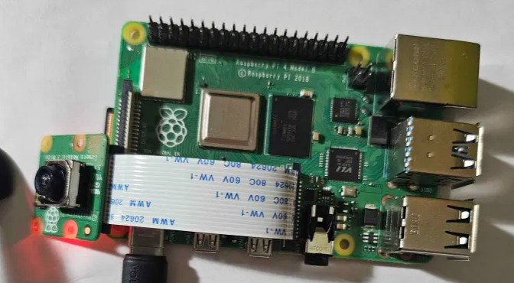
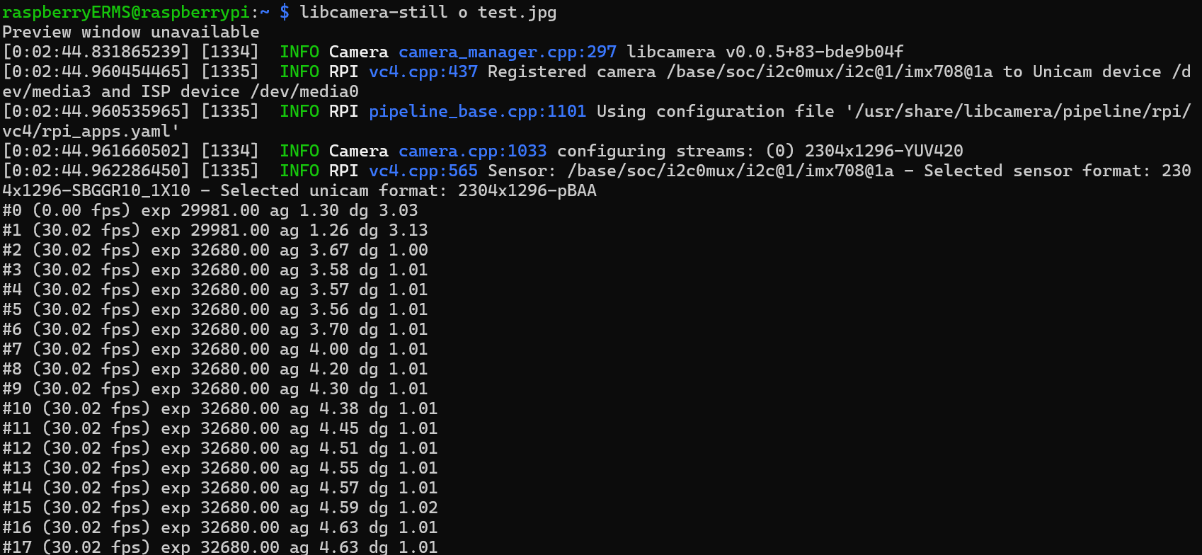
Multiplexer Test
Testing Camera Module by Itself
w/ Current Short Ribbon
This test confirms that both the camera and current short ribbon works properly
However, it wasn’t able to start a live feed

Slide 25
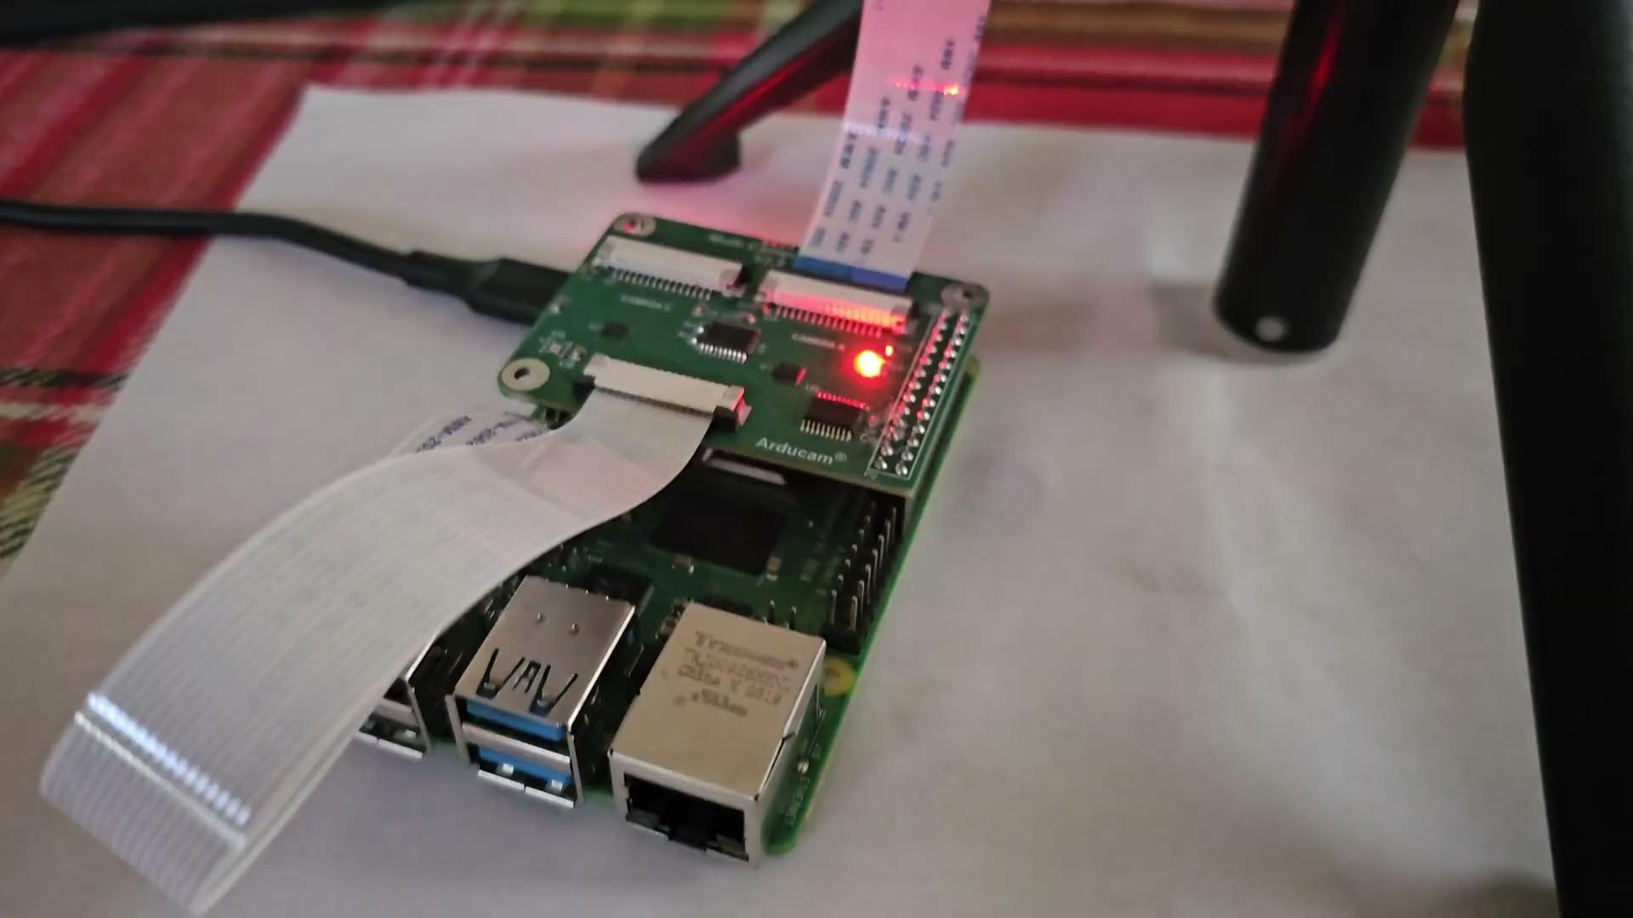
Multiplexer Test

Slide 26
Questions?

Slide 27
THANK YOU

